Slide 1
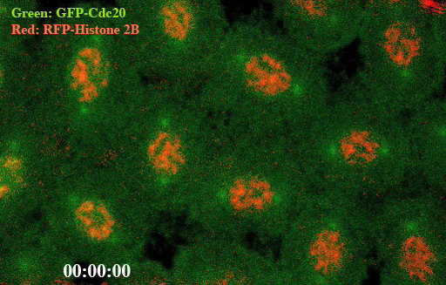
Individual cells in Drosophila (fruit fly) transgenic syncytial embryo were marked by GFP-Cdc20 fusion protein in green and RFP-Histone 2B fusion protein in red. The time-lapse movie showing the GFP-Cdc20 (Fzy in Drosophila) kinetochore recruitment and its dynamic distribution throughout the nuclear division cycle in a syncytial embryo. The RFP-Histone 2B chromosome signal used to indicate the dynamic of the chromosome (Huang’s lab).

